Slide 1
OTP verification system
python capstone project
St Id: S8170

Slide 2
Index
Problem statement
Project flow
Libraries used
Test cases
Applications

Slide 3
Problem statement
Develop a secure OTP verification system to authenticate users by generating, sending, and validating one-time passwords.

Slide 4
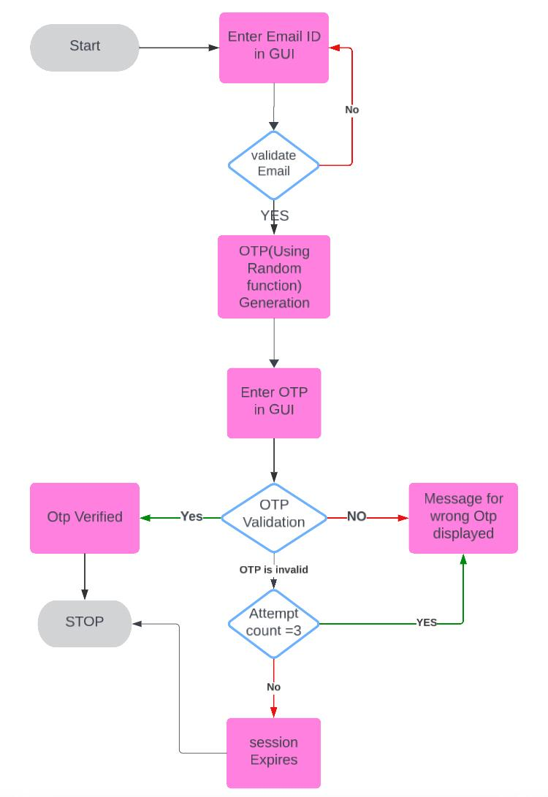
Project flow

Slide 5
Libraries used and purpose
smtplib: Sends emails using the Simple Mail Transfer Protocol (SMTP).
random: Generates random numbers, useful for creating OTPs.
email.mime.text.MIMEText: Creates plain text email content.
email.mime.multipart.MIMEMultipart: Manages email with multiple parts, such as text and HTML.
tkinter: Provides tools to create GUI.
tkinter.messagebox: Displays pop-up message boxes in tkinter applications.

Slide 6
Test cases
Invalid Email Id: Error will display and again enter the email
Valid Email and Valid OTP: Access Granted
Valid Email and Invalid OTP: Checking the no of attempts and displaying the result according to that.

Slide 7
Applications
Banking Transactions: Verifying the identity of users during online banking transactions to prevent fraud.
Password Resets: Securing the process of resetting forgotten passwords by sending an OTP to the user's registered email or phone number.
E-commerce: Confirming purchases or transactions to ensure that the user making the transaction is the legitimate account holder.
User Registration: Verifying the authenticity of users during the sign-up process for new accounts or services.
Mobile Payments: Ensuring the security of transactions made through mobile payment apps.
Subscription Services: Verifying new subscriptions to prevent unauthorized access and ensure that only legitimate users subscribe.
Voting Systems: Authenticating voters in online or electronic voting systems to prevent electoral fraud.

Slide 8
Thank you
St Id: S8170

